Slide 1


Team 5 research project
Presented by Clinton Agu, monea ester, saiquan Jamison, Robert Houston & Byron tolson

Slide 2
Table of content
INTRODUCTION
The Research Question
Data Set
METHODOLOGY
Data Wrangling (Pivot table, sorting and filtering)
REGIONS
COMMUNICATING RESULTS
RECOMMENDATIONS
QUESTIONS
WORK CITED
The five regions of the United States: Western Region, Midwest, Southwest, Southeast and Northeast
The result of the research analysis including online research
Each team members Recommendation
If any?
-

Slide 3


INTRODUCTION
RESEARCH PROBLEM:
Why did rental growth cost slow down in the home building boom?
Why is rental growth cost increasing rapidly as opposed to home ownership in 2015?

Slide 4

BEFORE WE GET STARTED PLEASE NOTE:
The data set is from the Zillow Rent Index.
The initial appearance of dates were changed.
Missing and duplicate data were removed or excluded.
All numeric values are in dollar amount. No CONVERSIONS were made.
The variables for the final analysis are State Code, County, Dates (Months) and State Code (new variable)
Additional data was referenced to help address the scenario.

Slide 5
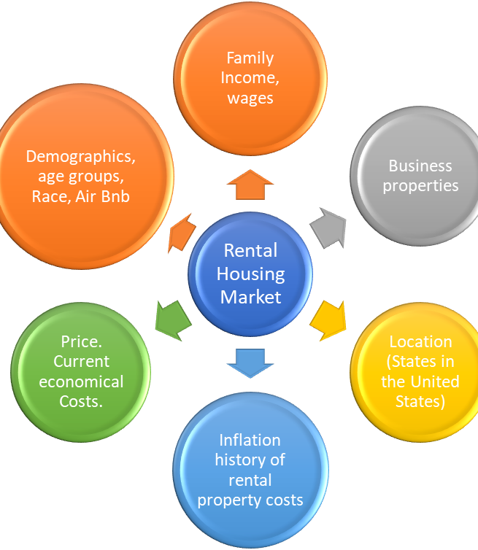
cont.…1
PRELIMINARY RESEARCH QUESTIONS

Slide 6
CONT…..2
Data set used:
Price Data set
Why?
The dataset best suited to answer the research problem.

Slide 7
Western region
Western Region Rental Housing Average from 2011 to 2016 (United States)

Slide 8
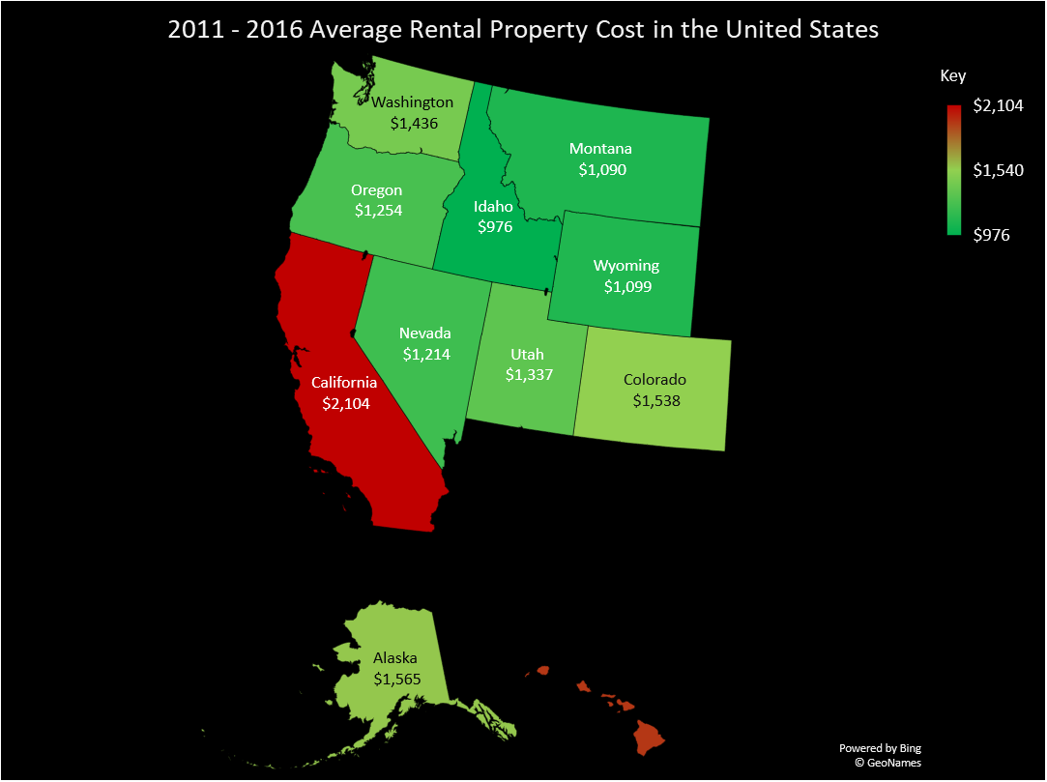
Western Region Analysis Summary
Lowest state: Idaho (ID)
Highest State: California (CA)

Slide 9
Southwest Region
Southwest Region Rental Housing Average from 2011 to 2016 (United States)

Slide 10
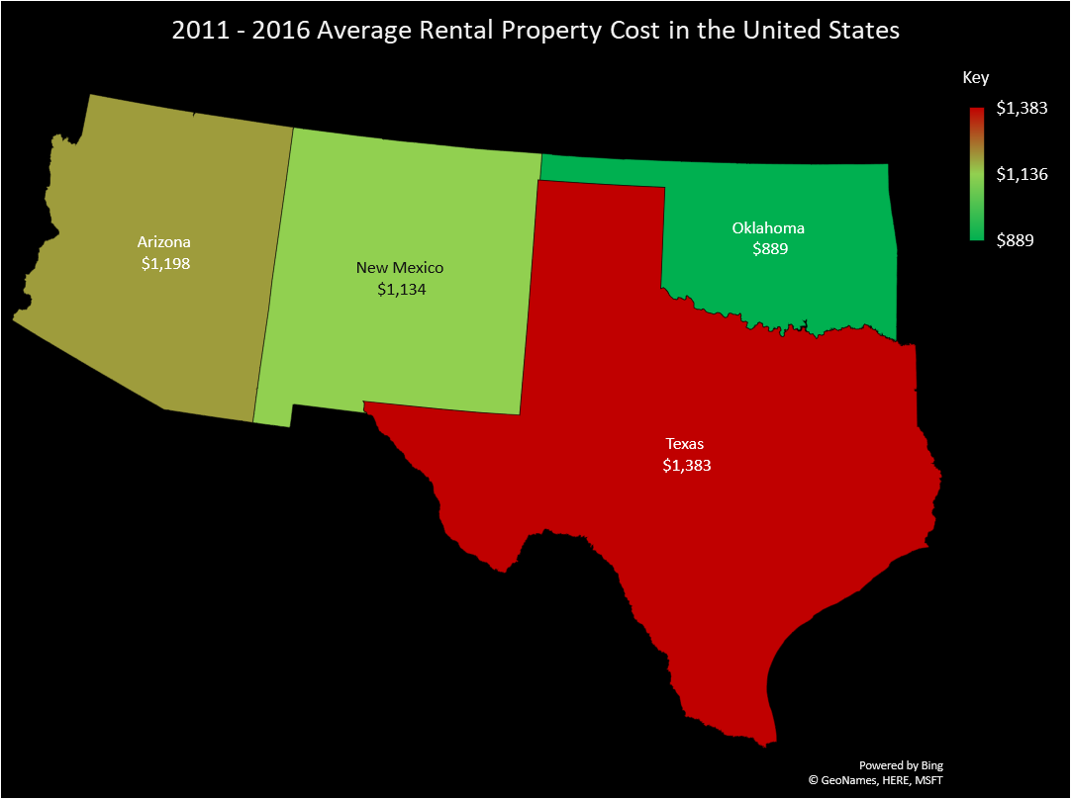
Southwest region analysis summary
Lowest State: Oklahoma (OK)
Highest State: Texas (TX)

Slide 11
Midwest region

Slide 12
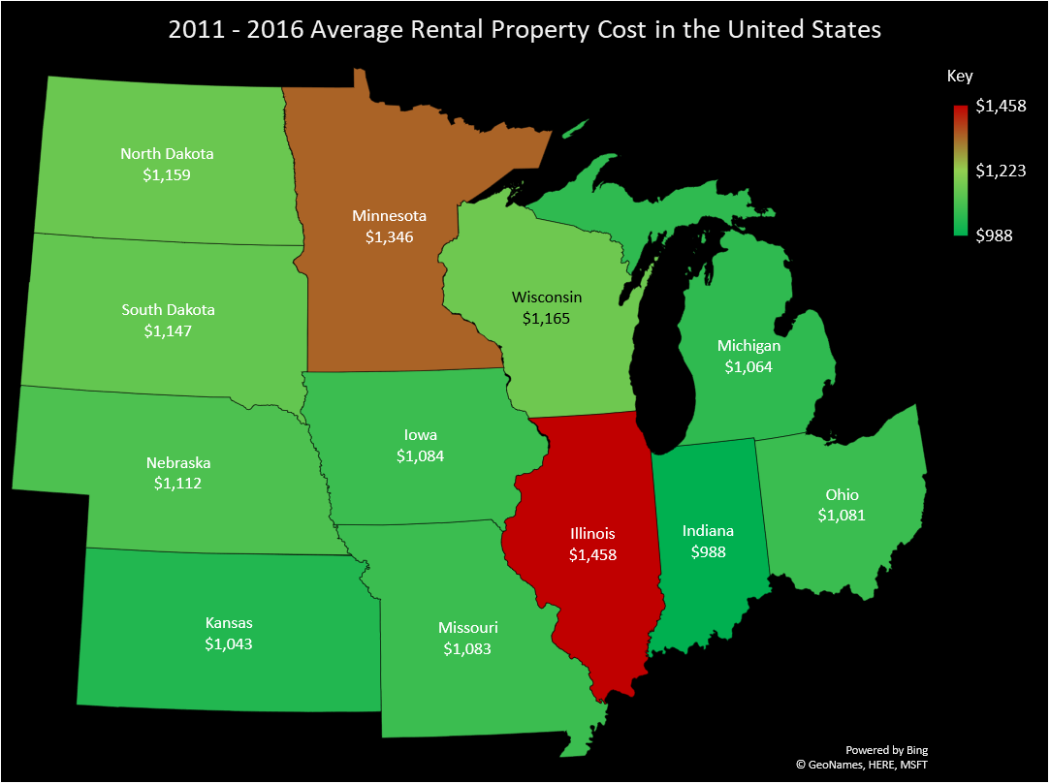
Midwest region analysis summary
Lowest State: Indiana (IN)
Highest State: Illinois (IL)

Slide 13
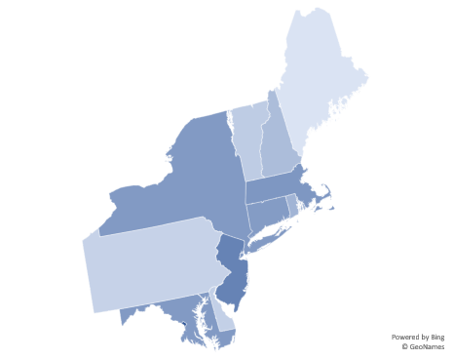
North East Region
Maryland, Delaware, Pennsylvania, New Jersey, New York, Vermont, New Hampshire, Massachusetts, Connecticut, Road Island, Maine, and District of Colombia.

Slide 14
Graph Analysis
This graph shows the average prices of rental homes and apartments of the northeast region of the United State. The states shown, Pennsylvania, Maine, New Jersey, and D.C, are the two lowest and highest.
Between 2012 and 2016, DC rental price inflated 7%, ME 22%, NJ 10%, and PA 4%.

Slide 15
Southeast region

Slide 17
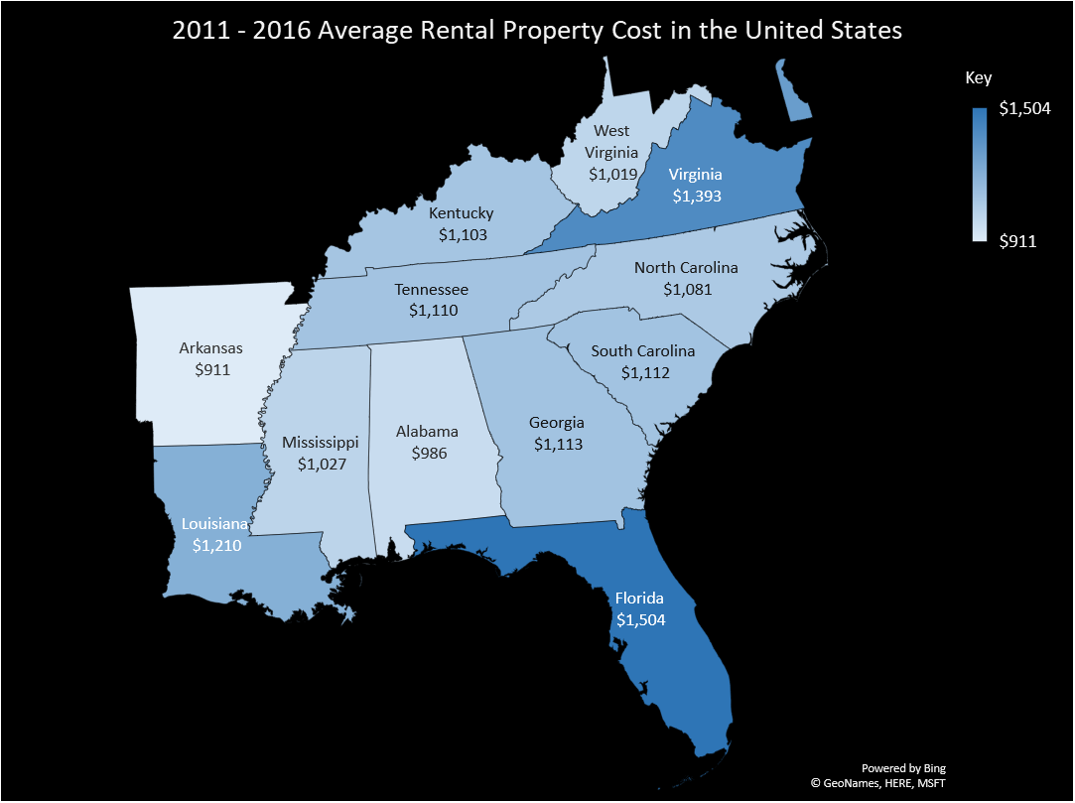
Southeast region
State with Lowest price: Alabama (AL)
State with highest price: Florida (FL)

Slide 18
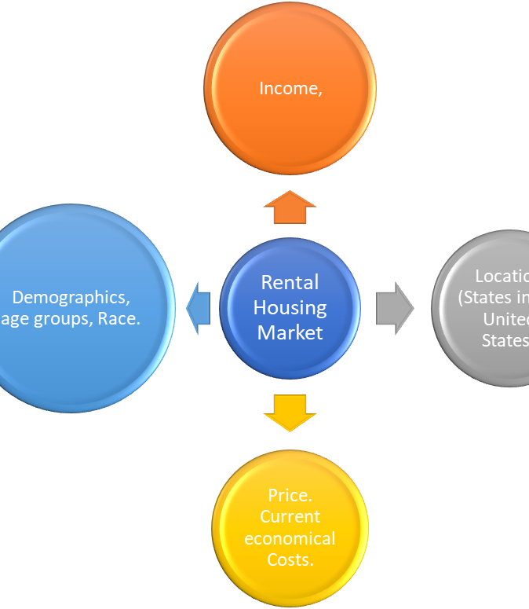
Revised RESEARCH QUESTIONS
Business properties
Family
Inflation history replaced with cost tread

Slide 19
Table showing top five states with highest average rental property cost in the united states 2011 - 2016.
STATES | 2011 | 2012 | 2013 | 2014 | 2015 | 2016 | AVERAGE
CA | $1,970 | $1,951 | $1,988 | $2,079 | $2,262 | $2,375 | $2,104
NJ | $1,977 | $1,955 | $1,986 | $2,038 | $2,111 | $2,143 | $2,035
HI | $1,835 | $1,834 | $1,918 | $1,915 | $2,083 | $2,149 | $1,956
MA | $1,743 | $1,776 | $1,789 | $1,841 | $1,991 | $2,081 | $1,870
MD | $1,746 | $1,747 | $1,773 | $1,787 | $1,830 | $1,829 | $1,785

Slide 20
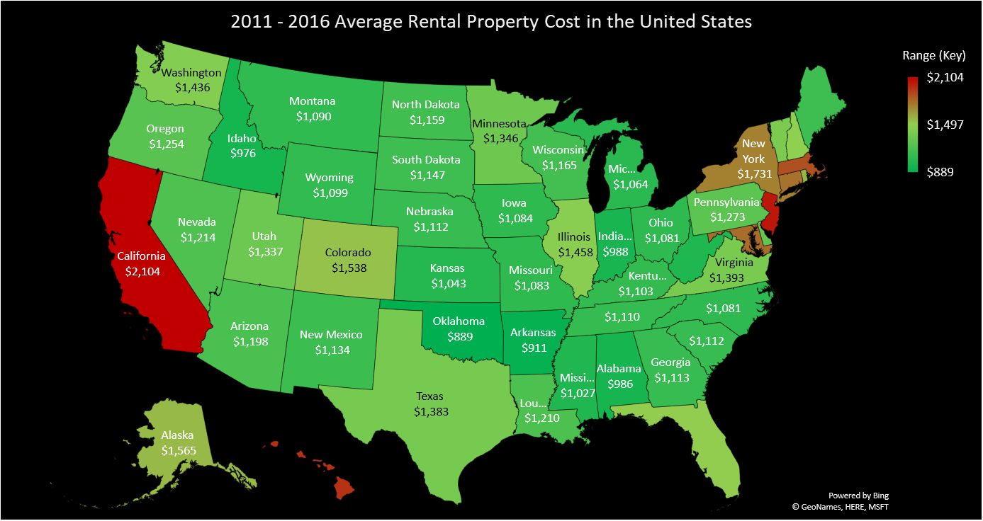

Slide 21


EDUCATION, Income and housing
Education in America
Lower graduation rate.
Ranking in education system has dropped.
Job requirement OR criteria met.
How it affects housing
Settling down time i.e. having a family, is greatly increased.
Purchasing power is severely reduced.

Slide 22
DID you know…

Slide 23
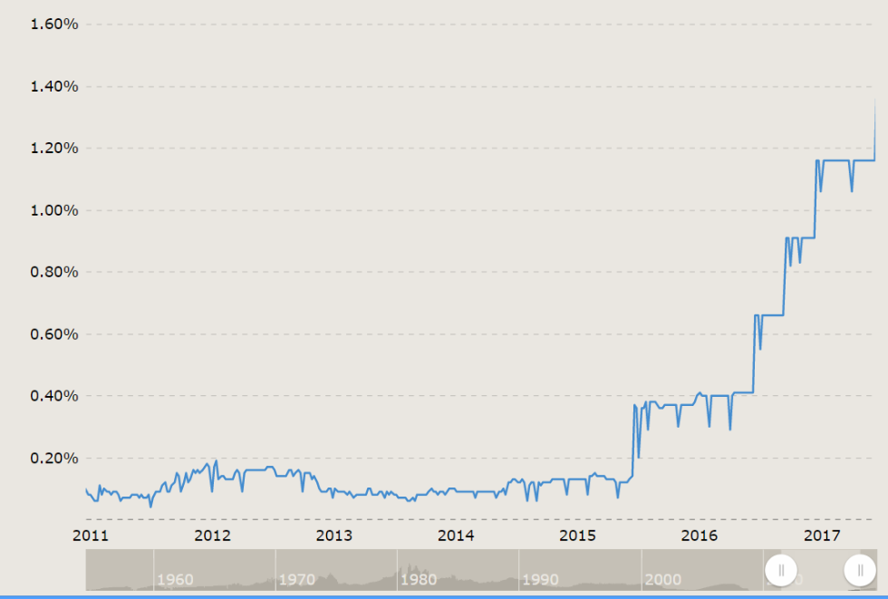


Interest rates and housing

Slide 24

TEAM RECOMMENDATION & OPINION

Slide 25

TEAM RECOMMENDATION
Better incentive for first time home buyers.
Consider improving the educational systems.
Reducing the cost of higher education.

Slide 26

INDIVIDUAL TEAM MEMBER OPINION
Clinton Agu
Monea Esther
Robert Houston
Saiquan Jamison
Tolson Byron

Slide 27

QUESTIONS

Slide 28
WORKS CITED
Riquier, Andrea. “We're Probably at Peak Housing. Here's What That Means.” MarketWatch, 30 June 2018, Click Here.
Schuetz, Jenny, and Jenny Schuetz. “Who Is the New Face of American Homeownership?” Brookings, Brookings, 9 Jan. 2018, Click Here
“11 Facts About Education in America.” DoSomething.org, www.dosomething.org/us/facts/11-facts-about-education-america.

